Slide 1
Presentation 1
COIT11241
JAMIE SHIELD TERM 2 2023
CHELSEA AJISAKA
FRANCIS RENZAHO
MATHEW GALLEHAWK

Slide 2
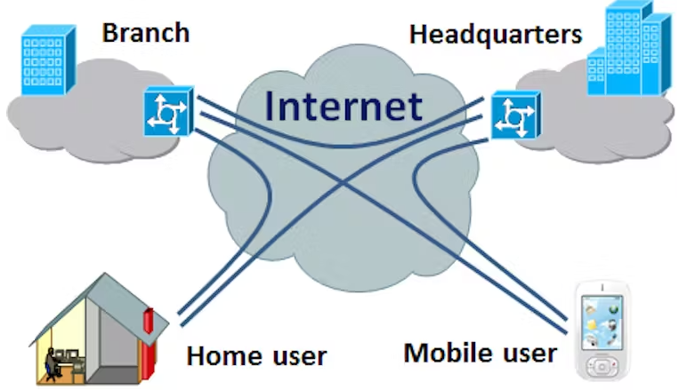




What is VPN
VIRTUAL PRIVATE NETWORK.
UTILISES AN ENCRYPTED COMMUNICATION TUNNEL THROUGH THE WAN/WEB.
BRIDGES BRANCHES (SITE-TO-SITE) OR DEVICES (CLIENT VPN) SEPARATED BY THE WAN ONTO THE SAME LAN.
IMG: illustration of VPN. https://theconversation.com/explainer-what-is-a-virtual-private-network-vpn-12741
CAN BE USED TO OBFUSCATE NETWORK TRAFFIC FOR REASONS OF PRIVACY.

Slide 3
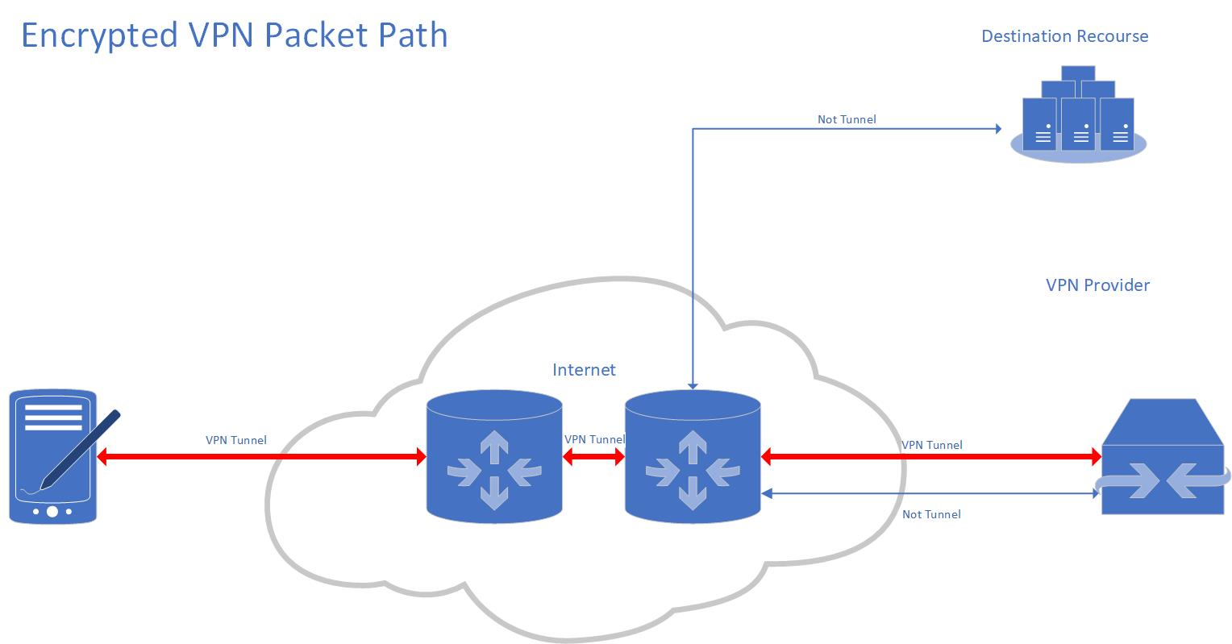
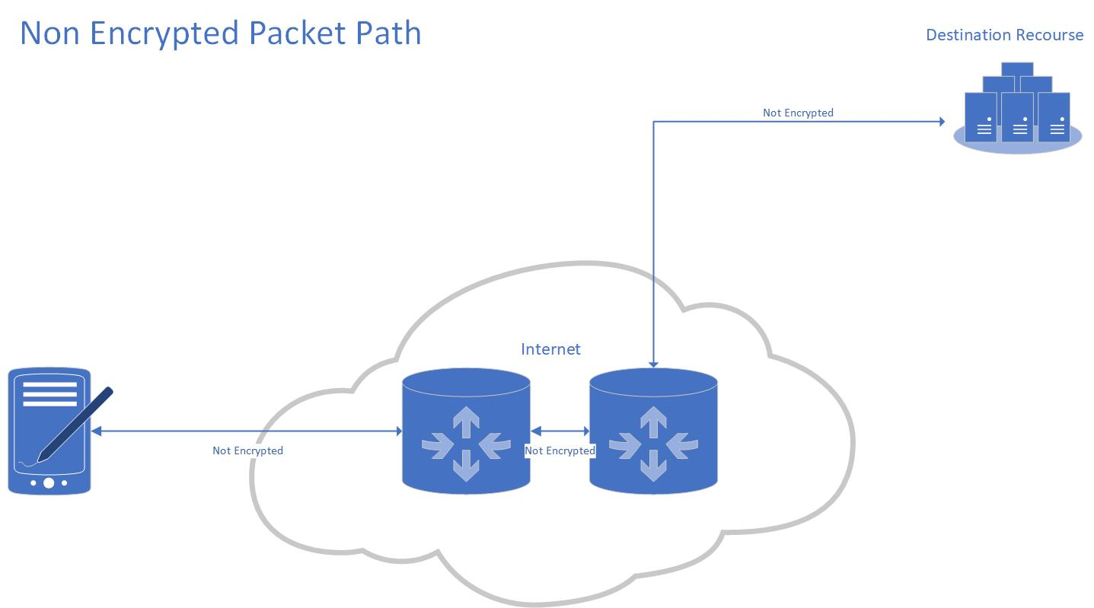
How VPN works.
VPN client and host establish a network path through the WAN.
VPN hosts and clients utilised shared secret for communication encryption.
Packets passed through the tunnel are encapsulated (encrypted and issued a new header).
Packets received are de-encapsulated and travel through the LAN as they were before.

Slide 4
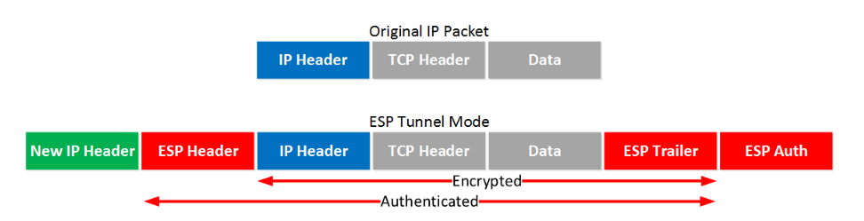
Encapsulation
Two main protocols:
Authentication Header (AH) offers no encryption in the tunnel.
Encapsulating Security Payload (ESP) encrypts the original packet.
ESP takes the original packet, encrypts it and adds Authentication algorithm information as well as a new IP header for the journey through the tunnel.
Img: ESP tunnel Mode https://networklessons.com/cisco/ccie-routing-switching/ipsec-internet-protocol-security

Slide 5
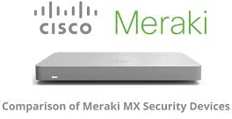
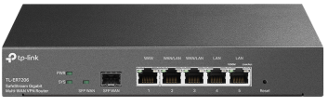
VPN Infrastructure
VPN Gateways are devices that facilitate the establishment of the VPN tunnel.
These devices specialise in encapsulating and de-encapsulating packets, reducing the computational workload of the client devices thus improving throughput.
VPN Gateways also allow the administrators to configure who can connect, how they connect (certificate or credential), and where they connect to (VLAN).
As technology improves this functionality is being integrated more into the enterprise routers.

Slide 6
VPN vs CIA principals.
Positive | Principal | Negative
Encapsulation /Encryption Protects against: Malware Injection DNS Spoofing Packet Sniffing Obfuscate digital identity mitigating OSINT Attacks. | Confidentiality | Endpoint safety: Insecure endpoints can become an attack vector to corporate networks.
IPsec /TLS validation AES Encryption | Integrity
Connects external branches and clients to share network resources. Circumvent Geoblocking. | Availability | Encapsulation requires computation by endpoint and routers/ VPN gateways, increasing latency. Encapsulation increases packet size. If a router in the VPN tunnel has a MTU smaller than the encapsulated packet, it will fragment the packet increasing latency.

Slide 7
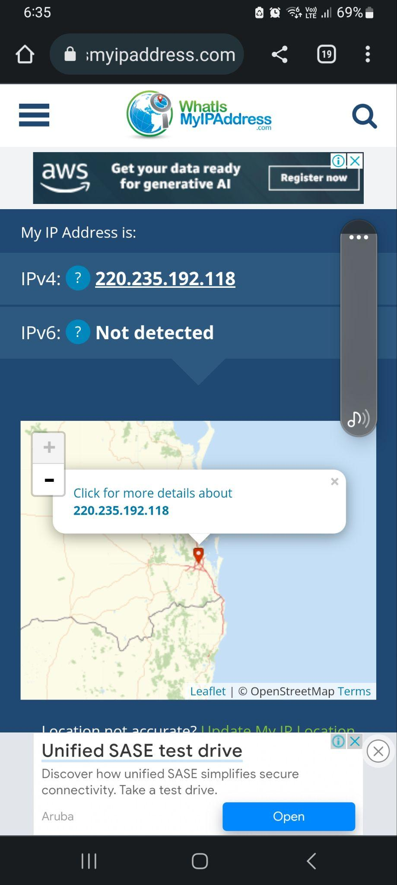
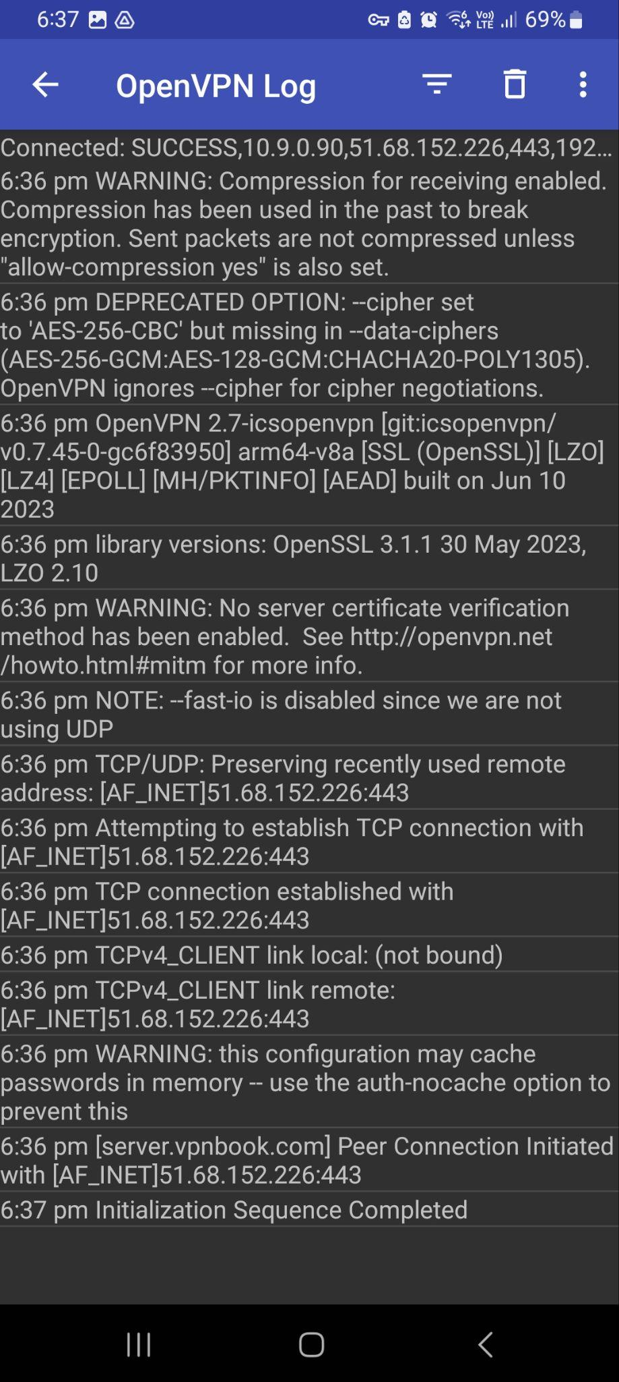
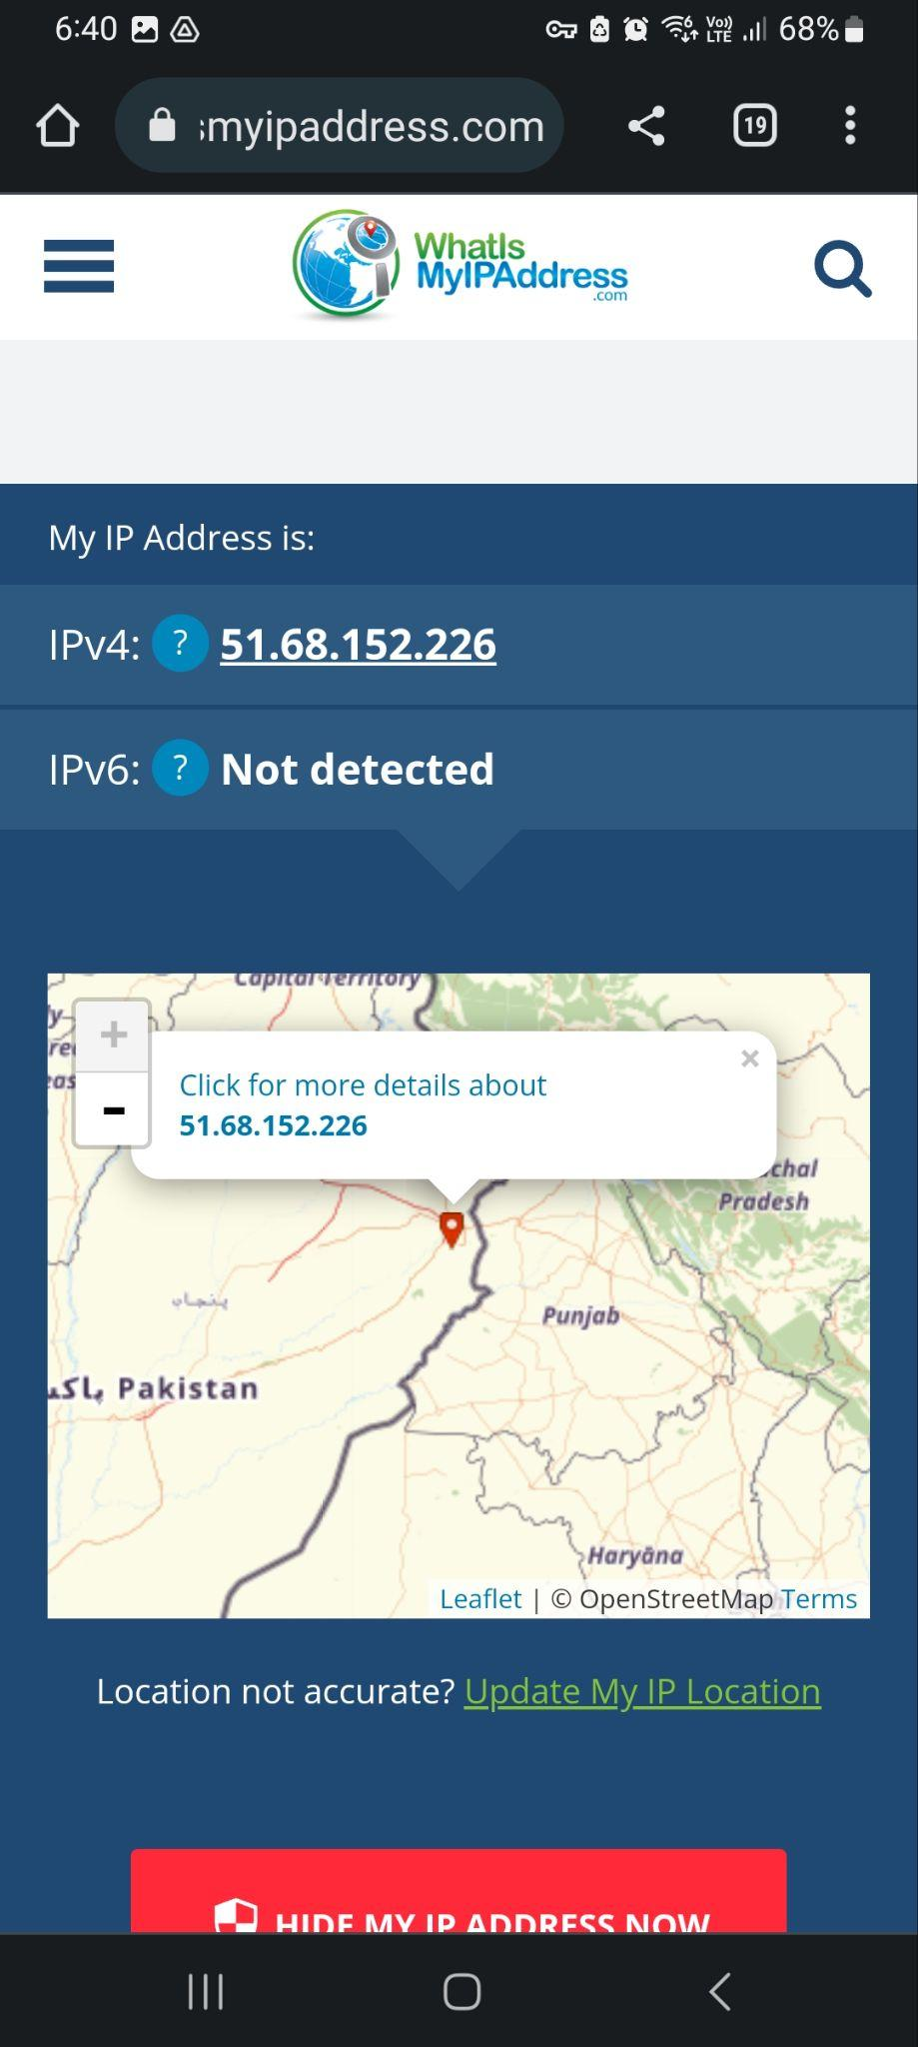
Demonstration
Public IP Before VPN connection
Connection LOG
Public IP After VPN connection

Slide 8



Explain why the public IP is different?
The public IP address changes when a machine uses a VPN as it redirects the machine’s internet traffic to a different server, in another location.
The VPN acts as a middleman between the machine and online websites and services, encrypting the data that the web server views.
This causes these online sites and services to perceive the VPN IP address rather than the machine’s original public IP address, keeping the user’s identity and location protected.

Slide 9

Explain how a VPN can prevent attacks on your mobile?
A VPN can prevent attacks on your mobile device by encrypting and altering the mobile’s public IP and redirecting internet traffic.
The alternation of the mobile’s IP address make it difficult for malicious actors to target the device. These protocols that are put in place ensure that any malicious attackers are unable or find difficult to obtain sensitive and private information or data.
The use of a VPN significantly increase the mobile’s internet security and privacy, protecting the user from cyber attacks, malicious actors, and threats.

Slide 10
Discussion and conclusion
VPN technology:
Increases computational demand and network latency due to packet encapsulation & fragmentation.
Provides a method of securely bridging LAN networks across the WAN, allowing for the sharing of network resources.
Allows external Endpoint devices access to Internal resources, particularly in WFH environments.
WFH endpoint devices can become an attack vector if not properly controlled.
VPN usage allows the endpoint device to communicate to the WAN through the Host gateway, using the Host Public IP.

